Slide 1
Indian Language and Code-Mixed Text Identification Using Ground-Up Character N-Gram TF-IDF, Naive Bayes, and Softmax Classifiers
A
अ
ಅ
Abstract
Finds which language(s) a sentence uses, from 7 classes: English, Hindi, Kannada and their mixes
Also finds the points where the language switches, using word-level tags
Built from scratch in plain Python: character n-gram TF-IDF, Naive Bayes, softmax classifier
Data: 3,500 sentences (2,779 train, 371 validation, 350 test)
Switch points come from the given tags, not from predictions
Group 15
Bandi Thanish Kumar
Roll No. 25BEC012
Naive Bayes
Softmax
Pranav Bharadwaj
Roll No. 25BEC050
90.29%
89.43%
Manu S Ullikashi
Roll No. 25BEC037
macro-F1 0.9029
macro-F1 0.8888
Dewang Sharma
Roll No. 25BEC022

Slide 2
Introduction
People in India often mix languages in one sentence
Chat text mixes Hindi, Kannada and English, often with informal spellings [1], [2]
Normal NLP tools struggle: messy spellings, informal grammar, many unseen words [1], [3]
We build a simple, transparent pipeline without ML libraries like scikit-learn
1
Sentence classification
Put each sentence into one of 7 classes: 3 single-language and 4 mixed. There are 500 sentences per class.
2
Switch-point extraction
List the word positions where the language tag changes, using the dataset’s word-level tags.

Slide 3
Literature Review
1
Language identification
2
Corpus studies
3
Other tasks
Code-mixing makes language identification hard on social media [1].
English–Hindi mixing on Facebook was studied [2]; how much code-switching a corpus has was measured [4].
POS tagging [3] and sentiment analysis [5] were adapted for mixed Hindi–English text.
4
Benchmark
5
Character n-grams
6
Indian-language resources
GLUECoS is a benchmark for code-switched NLP [6].
A classic method for language identification and text classification [7]; sub-word features help with noisy text [5].
AI4Bharat IndicNLP collects them [8].

Slide 4
Method 1: Character N-Gram TF-IDF
Raw sentence
Char 2–3gram TF-IDF
ManualNB / ManualLinear
Category (7 classes)
Lowercase the text, fix spaces, add a space at both ends
Count character n-grams of length 2 to 3
Vocabulary and document counts come from training data only
Weight counts by IDF, then normalize (L2)
n-grams not seen in training are ignored at test time
Smoothed IDF [12], [13] (1)
IDF(g) = ln( (1 + N) / (1 + DF(g)) ) + 1
L2-normalized weight (2)
v_{g} = TF(g,d)·IDF(g) / norm
norm = √( Σ_{k} (TF(k,d)·IDF(k))² )

Slide 5
Method 2: Multinomial Naive Bayes
Multinomial Naive Bayes [14] with Laplace smoothing (α = 1)
TF-IDF weights are used as fractional counts
Class priors come from training sentence counts; V = vocabulary
Class prior (3)
log P(C_{c}) = log( N_{c} / N )
Feature likelihood (4)
log P(f_{g} | C_{c}) = log (Σ_{i∈Cc} x_{i,g} + α)
/ (Σ_{k} Σ_{i∈Cc} x_{i,k} + α|V|)
ManualNB
90.29%
Prediction (5)
ŷ = argmax_{c} ( log P(C_{c}) + Σ_{g} x_{g} log P(f_{g} | C_{c}) )
test accuracy (316/350)

Slide 6
Method 3: Softmax Model & Comparison
Softmax probability (6)
 | ManualNB | ManualLinear
Model | Multinomial NB [14] | Softmax regression [15]
Training | Counts per class | SGD, 35 epochs
Smoothing / regularization | Laplace α = 1 | None
Accuracy | 90.29% | 89.43%
Macro-F1 | 0.9029 | 0.8888
Trilingual recall | 0.96 | 0.62
P(y=k | x) = exp( b_{k} + Σ_{j} W_{k,j} x_{j} )
/ Σ_{m} exp( b_{m} + Σ_{j} W_{m,j} x_{j} )
SGD update (7), (8)
W_{k,j} ← W_{k,j} − η (P(y=k | x) − δ_{k,y}) x_{j}
Trained one sentence at a time with SGD on cross-entropy loss: η = 0.15, 35 epochs, start from zero, no regularization.

Slide 7
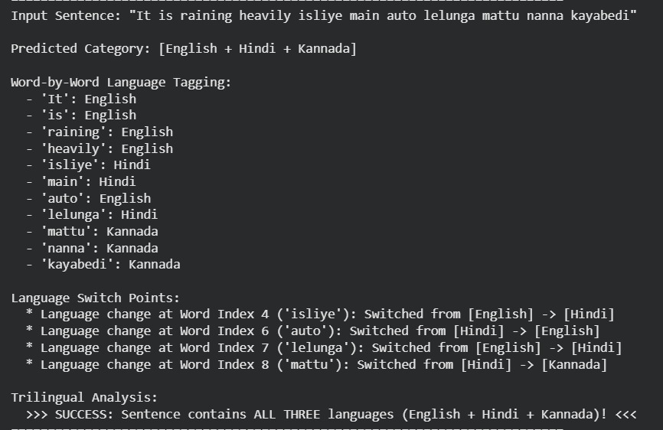
Results
Class | Support | ManualNB |  |  | ManualLinear
 |  | P | R | F1 | P | R | F1
English | 43 | 0.84 | 0.95 | 0.89 | 0.84 | 1.00 | 0.91
English + Hindi | 49 | 0.91 | 0.82 | 0.86 | 0.79 | 0.92 | 0.85
English + Hindi + Kannada | 45 | 0.96 | 0.96 | 0.96 | 1.00 | 0.62 | 0.77
English + Kannada | 55 | 0.92 | 0.80 | 0.85 | 0.88 | 0.84 | 0.86
Hindi | 51 | 0.87 | 0.94 | 0.91 | 0.94 | 0.94 | 0.94
Kannada | 53 | 0.86 | 0.96 | 0.91 | 0.93 | 1.00 | 0.96
Kannada + Hindi | 54 | 0.98 | 0.91 | 0.94 | 0.93 | 0.93 | 0.93
Macro-F1 / Accuracy | 350 | 0.9029 / 90.29% |  |  | 0.8888 / 89.43%
Sample output: category, word-by-word tags and switch points for one sentence
Test accuracy: Naive Bayes 316/350 = 90.29%, softmax 313/350 = 89.43%.
Always guessing the biggest class gives only 55/350 = 15.7%.
With 350 test sentences the margin of error is about ±3 points, and the models differ by only 3 sentences. So we cannot say Naive Bayes is truly better.

Slide 8
Discussion & Conclusion
ManualNB
ManualLinear
 | E | EH | EHK | EK | H | K | KH
E | 41 | 1 | 0 | 1 | 0 | 0 | 0
EH | 4 | 40 | 0 | 0 | 5 | 0 | 0
EHK | 0 | 0 | 43 | 1 | 0 | 0 | 1
EK | 4 | 0 | 0 | 44 | 0 | 7 | 0
H | 0 | 3 | 0 | 0 | 48 | 0 | 0
K | 0 | 0 | 0 | 0 | 2 | 51 | 0
KH | 0 | 0 | 2 | 0 | 2 | 1 | 49
 | E | EH | EHK | EK | H | K | KH
E | 43 | 0 | 0 | 0 | 0 | 0 | 0
EH | 3 | 45 | 0 | 0 | 1 | 0 | 0
EHK | 0 | 7 | 28 | 6 | 0 | 0 | 4
EK | 5 | 0 | 0 | 46 | 0 | 4 | 0
H | 0 | 3 | 0 | 0 | 48 | 0 | 0
K | 0 | 0 | 0 | 0 | 0 | 53 | 0
KH | 0 | 2 | 0 | 0 | 2 | 0 | 50
Conclusion
Naive Bayes: 90.29% accuracy (macro-F1 0.9029); softmax: 89.43% (macro-F1 0.8888)
The difference is within sampling uncertainty
Both confuse two-language sentences with one language; softmax also misses three-language sentences
Next step: word-level models (CRF, recurrent) to predict switch points
Rows = actual, columns = predicted. E = English, H = Hindi, K = Kannada (EHK = all three).
Discussion
Naive Bayes: 34 errors; 20 (59%) are English+Kannada (11) and English+Hindi (9), mostly labelled as one of their own two languages
Softmax: 37 errors; 17 are three-language sentences, always labelled as two languages (recall 0.62 vs 0.96 for Naive Bayes)
Single-language sentences are rarely wrong; softmax is better on English and Kannada recall (both 1.00)

